Slide 1
Chapter 3 Transport Layer
TCP - Flow Control

Slide 2

Chapter 3: roadmap
Transport-layer services
Principles of reliable data transfer
Connection-oriented transport: TCP
segment structure
reliable data transfer
flow control
connection management
Principles of congestion control
TCP congestion control

Slide 3

TCP flow control
application
process
Q: What happens if network layer delivers data faster than application layer removes data from socket buffers?
Application removing data from TCP socket buffers
TCP socket
receiver buffers
TCP
code
Network layer delivering IP datagram payload into TCP socket buffers
IP
code
from sender
receiver protocol stack
Notes:
(Presuming an intro)
Before diving into the details of TCP flow control, let’s first get the general context and motivate the need for flow control.
This diagram show a typical transport-layer implementation
A segment is brought up the protocol stack to the transport layer, and the segment’s payload is removed from the segment and written INTO socket buffers.
How does data get taken OUT of socket buffers? By applications performing socket reads, as we learned in Chapter 2.
And so the question is “What happens if network layer delivers data faster than an application-layer process removes data from socket buffers?”
Let’s watch a video of what happens when things arrive way too fast to fast to be processed.
<video>. (I love that video). Another human analogy showing the need for flow control is the saying – to use some English slang - “no one can drink from a firehose”
Flow control is a mechanism to the calamity of a receiver being over-run by a sender that is sending too fast – it allows the RECEIVER to explicitly control the SENDER so sender won’t overflow receiver’s buffer by transmitting too much, too fast

Slide 4
TCP flow control
application
process
Q: What happens if network layer delivers data faster than application layer removes data from socket buffers?
Application removing data from TCP socket buffers
TCP socket
receiver buffers
TCP
code
receive window
flow control: # bytes receiver willing to accept
IP
code
from sender
receiver protocol stack
Notes:
(Presuming an intro)
Before diving into the details of TCP flow control, let’s first get the general context and motivate the need for flow control.
This diagram show a typical transport-layer implementation
A segment is brought up the protocol stack to the transport layer, and the segment’s payload is removed from the segment and written INTO socket buffers.
How does data get taken OUT of socket buffers? By applications performing socket reads, as we learned in Chapter 2.
And so the question is “What happens if network layer delivers data faster than an application-layer process removes data from socket buffers?”
Let’s watch a video of what happens when things arrive way too fast to fast to be processed.
<video>. (I love that video). Another human analogy showing the need for flow control is the saying – to use some English slang - “no one can drink from a firehose”
Flow control is a mechanism to the calamity of a receiver being over-run by a sender that is sending too fast – it allows the RECEIVER to explicitly control the SENDER so sender won’t overflow receiver’s buffer by transmitting too much, too fast

Slide 5
TCP flow control
application
process
Q: What happens if network layer delivers data faster than application layer removes data from socket buffers?
Application removing data from TCP socket buffers
TCP socket
receiver buffers
TCP
code
flow control
receiver controls sender, so sender won’t overflow receiver’s buffer by transmitting too much, too fast
IP
code
from sender
receiver protocol stack
Notes:
(Presuming an intro)
Before diving into the details of TCP flow control, let’s first get the general context and motivate the need for flow control.
This diagram show a typical transport-layer implementation
A segment is brought up the protocol stack to the transport layer, and the segment’s payload is removed from the segment and written INTO socket buffers.
How does data get taken OUT of socket buffers? By applications performing socket reads, as we learned in Chapter 2.
And so the question is “What happens if network layer delivers data faster than an application-layer process removes data from socket buffers?”
Let’s watch a video of what happens when things arrive way too fast to fast to be processed.
<video>. (I love that video). Another human analogy showing the need for flow control is the saying – to use some English slang - “no one can drink from a firehose”
Flow control is a mechanism to the calamity of a receiver being over-run by a sender that is sending too fast – it allows the RECEIVER to explicitly control the SENDER so sender won’t overflow receiver’s buffer by transmitting too much, too fast

Slide 6
TCP flow control
TCP receiver “advertises” free buffer space in rwnd field in TCP header
RcvBuffer size set via socket options (typical default is 4096 bytes)
many operating systems auto-adjust RcvBuffer
sender limits amount of unACKed (“in-flight”) data to received rwnd
guarantees receive buffer will not overflow
to application process
RcvBuffer
buffered data
rwnd
free buffer space
TCP segment payloads
TCP receiver-side buffering
Notes:
Here’s how TCP implement flow control. The basic idea is simple – the receiver informs the sender how much free buffer space there is, and the sender is limited to send no more than this amount of data. That the value o RWND in the diagram to the right.
This information is carried from the receiver to the sender in the “receiver advertised window” (do a PIP of header) in the TCP header, and the value will change as the amount of free buffer space fluctuates over time.

Slide 7
TCP flow control
flow control: # bytes receiver willing to accept
TCP receiver “advertises” free buffer space in rwnd field in TCP header
RcvBuffer size set via socket options (typical default is 4096 bytes)
many operating systems auto-adjust RcvBuffer
sender limits amount of unACKed (“in-flight”) data to received rwnd
guarantees receive buffer will not overflow
receive window
TCP segment format
Notes:
Here’s how TCP implement flow control. The basic idea is simple – the receiver informs the sender how much free buffer space there is, and the sender is limited to send no more than this amount of data. That the value o RWND in the diagram to the right.
This information is carried from the receiver to the sender in the “receiver advertised window” (do a PIP of header) in the TCP header, and the value will change as the amount of free buffer space fluctuates over time.

Slide 8
15-6 WINDOWS IN TCP
TCP uses two windows (send window and receive window) for each direction of data transfer, which means four windows for a bidirectional communication.
To make the discussion simple, we make an assumption that communication is only unidirectional; the bidirectional communication can be inferred using two unidirectional communications with piggybacking.
TCP/IP Protocol Suite
‹#›
Notes:
‹#›

Slide 9
Topics Discussed in the Section
Send Window
Receive Window
TCP/IP Protocol Suite
‹#›
Notes:
‹#›

Slide 10
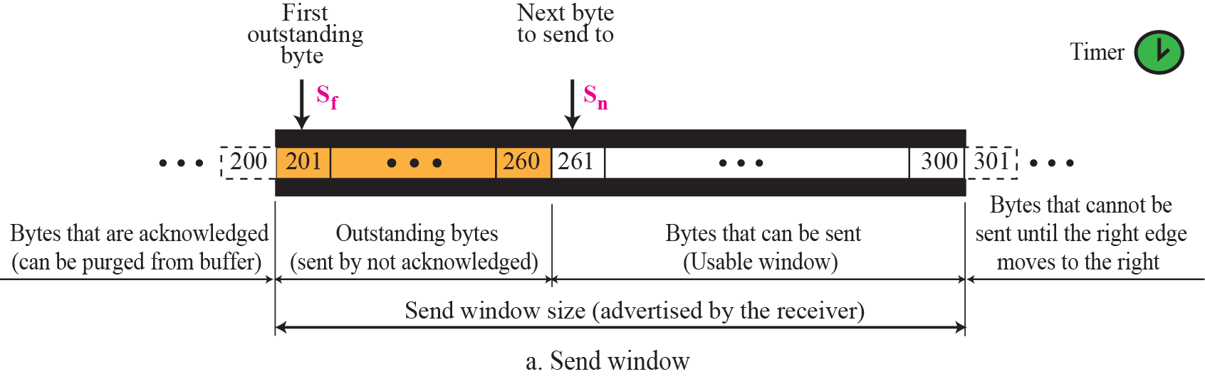
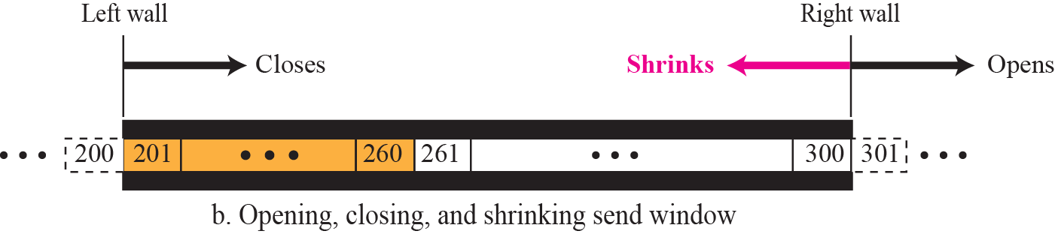
Figure 15.22 Send window in TCP
TCP/IP Protocol Suite
‹#›
Notes:
‹#›

Slide 11
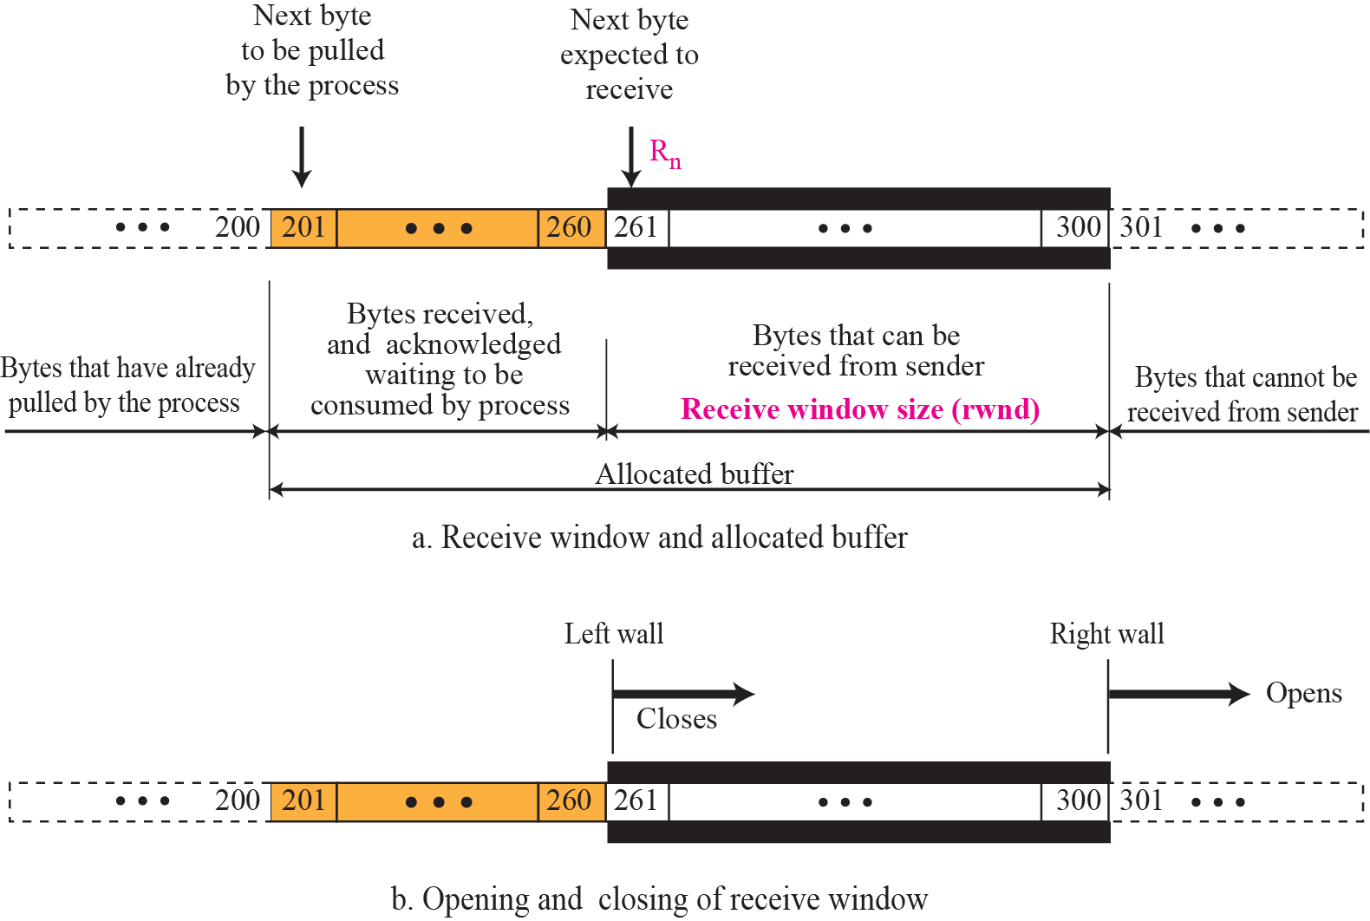
Figure 15.23 Receive window in TCP
TCP/IP Protocol Suite
‹#›
Notes:
‹#›

Slide 12
Flow control
Receiver window
Window can -
Open
Close
Shrink
Shutdown
spare room in buffer
= advertizedRcvWindow
= RcvBuffer-[LastByteRcvd - LastByteRead]

Slide 13
TCP Flow control: how it works
Sender maintain a variable RcvWindow
Rcvr advertises spare room by including value of RcvWindow in segments during ack
Sender limits unACKed data to RcvWindow
guarantees receive buffer doesn’t overflow
(LastByteSent – LastByteAckd)
≤ RecvWindow
(Sn - 1) – (Sf - 1)
≤ RecvWindow

Slide 14
Flow control
The amount of data a source can send before receiving an ACK from the destination
Whether to send 1 byte of data and wait for ACK or send all bytes and wait for the ACK for the complete message?
TCP gives a solution in between
Sliding window protocol
byte oriented

Slide 15
15-7 FLOW CONTROL
Flow control balances the rate a producer creates data with the rate a consumer can use the data.
Figure 15.24 shows unidirectional data transfer between a sender and a receiver; bidirectional data transfer can be deduced from unidirectional one as discussed in Chapter 13.
TCP/IP Protocol Suite
‹#›
Notes:
‹#›

Slide 16
Topics Discussed in the Section
Opening and Closing Windows
Shrinking of Windows
Silly Window Syndrome
TCP/IP Protocol Suite
‹#›
Notes:
‹#›

Slide 17
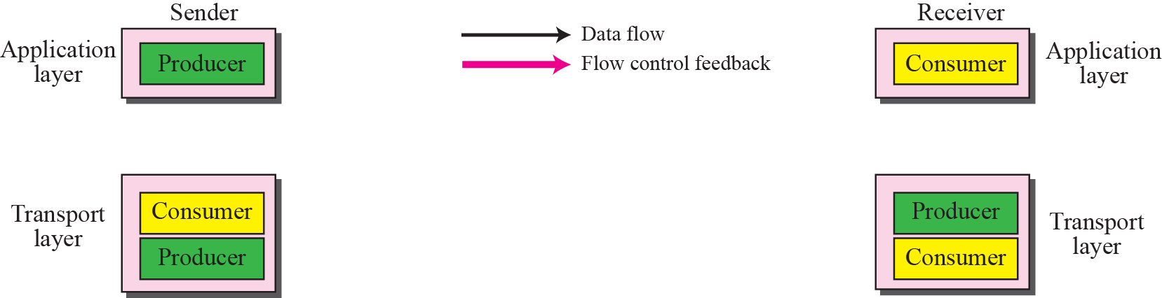
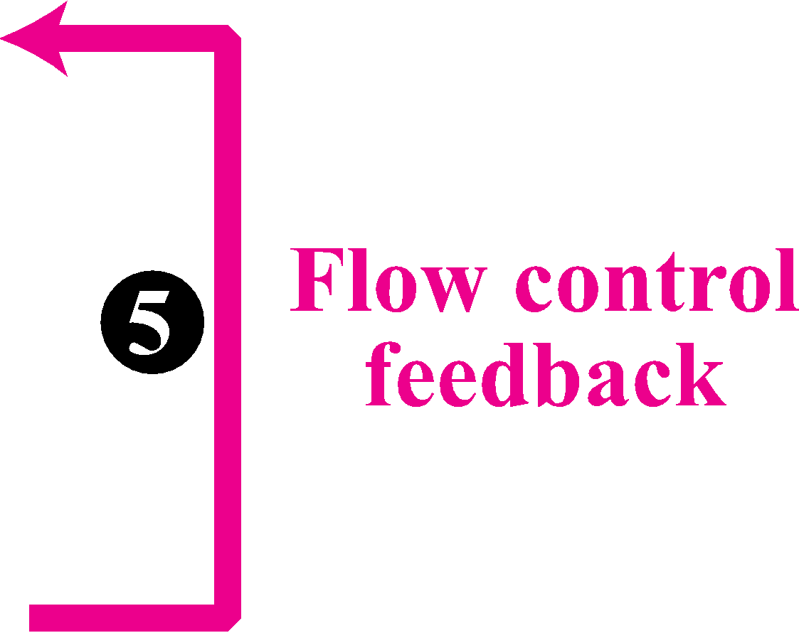
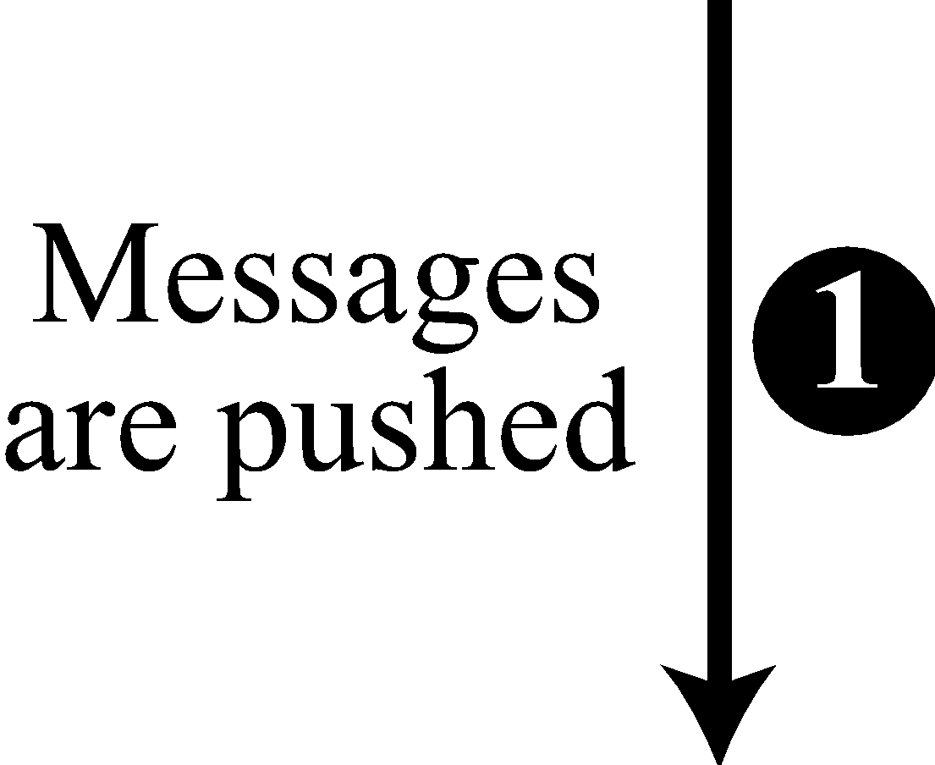
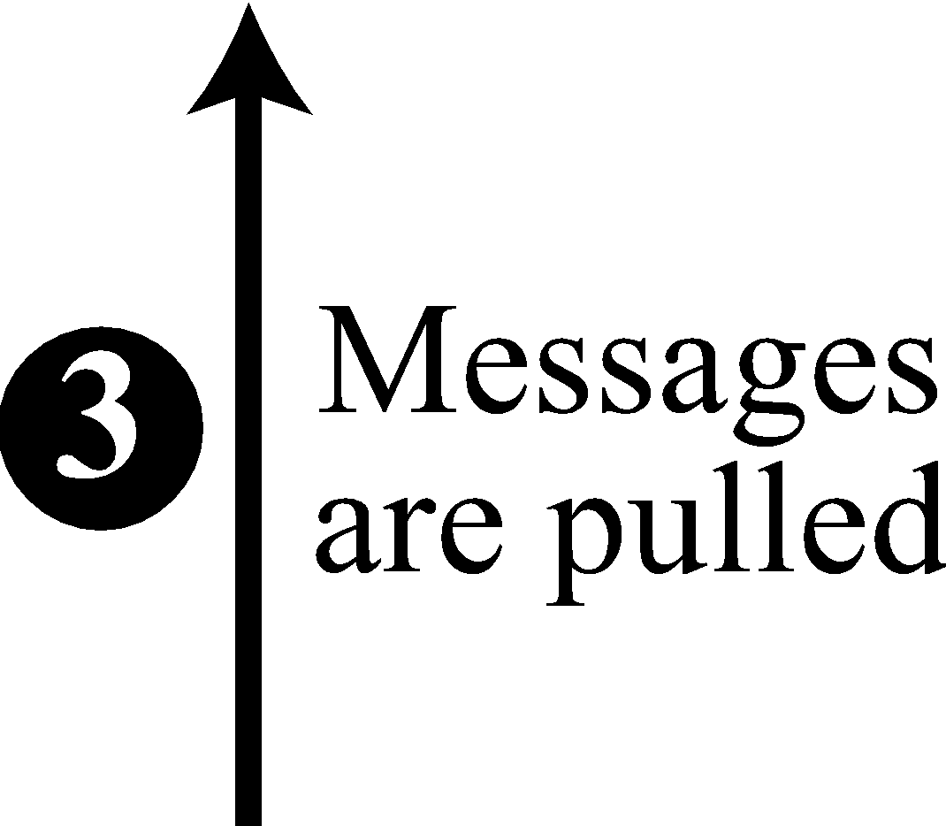
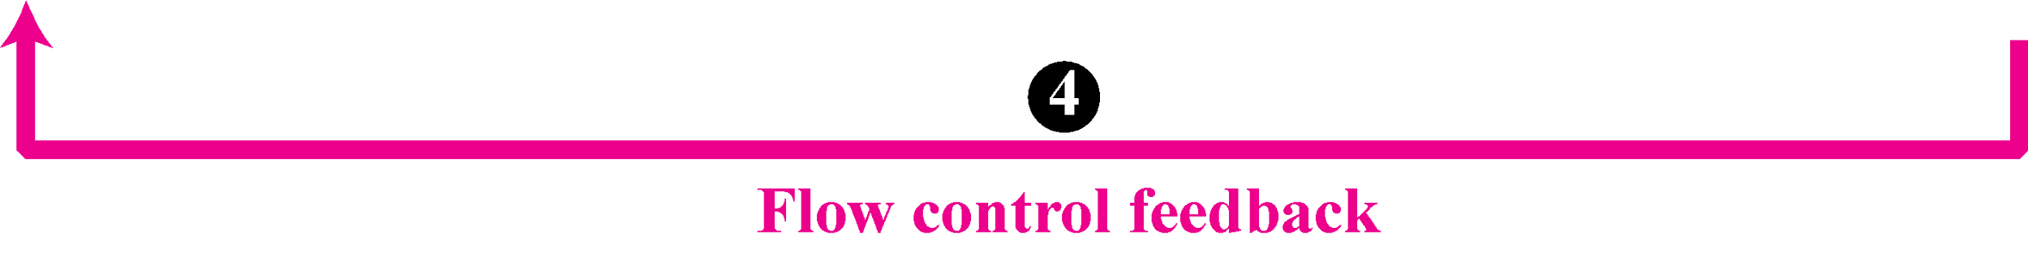
Figure 15.24 TCP/IP protocol suite
TCP/IP Protocol Suite
‹#›
Notes:
‹#›

Slide 18
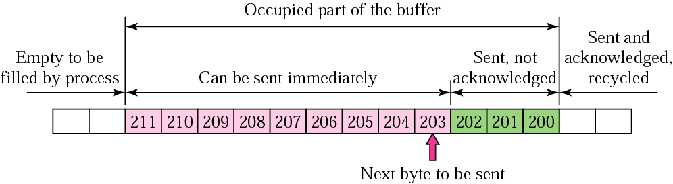
Flow control
sender buffer
Direction of transmission
If no window, a sender can send all bytes without regarding the condition of the receiver
if data are consumed too slowly then receiver buffer becomes full -> drop the packet (retransmit)
Hence, the sender must adjust itself to the number of the free locations in the receiver buffer

Slide 19
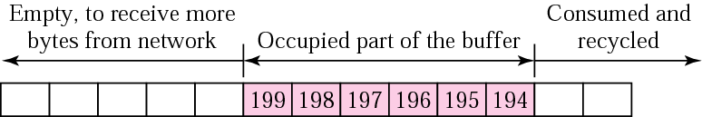
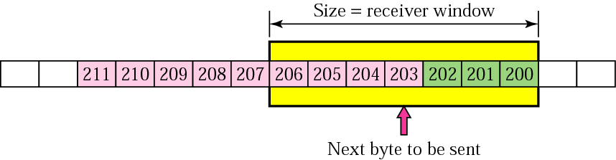
Flow control
Receiver window
M
N
N-M = receiver window
Sender window

Slide 20
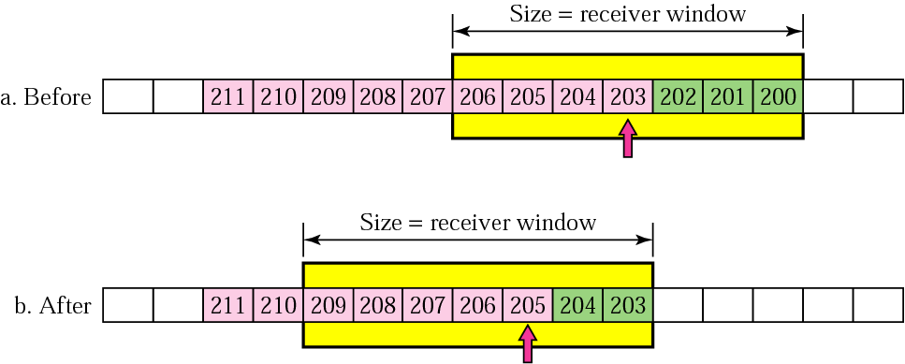
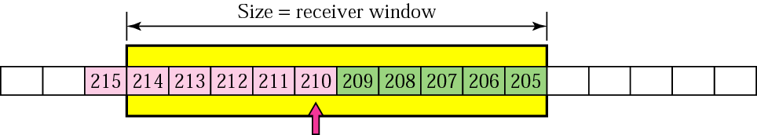
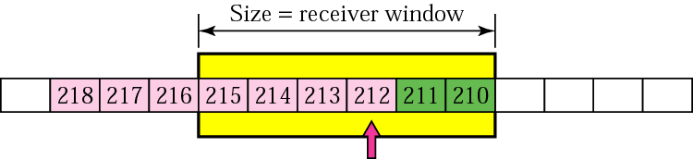
Flow control
Direction of window shift
sliding widow
ACK is received for bytes 200-202
the sender can send bytes 205-209
Direction of transmission
expanding the sender widow
shrinking the sender widow

Slide 21
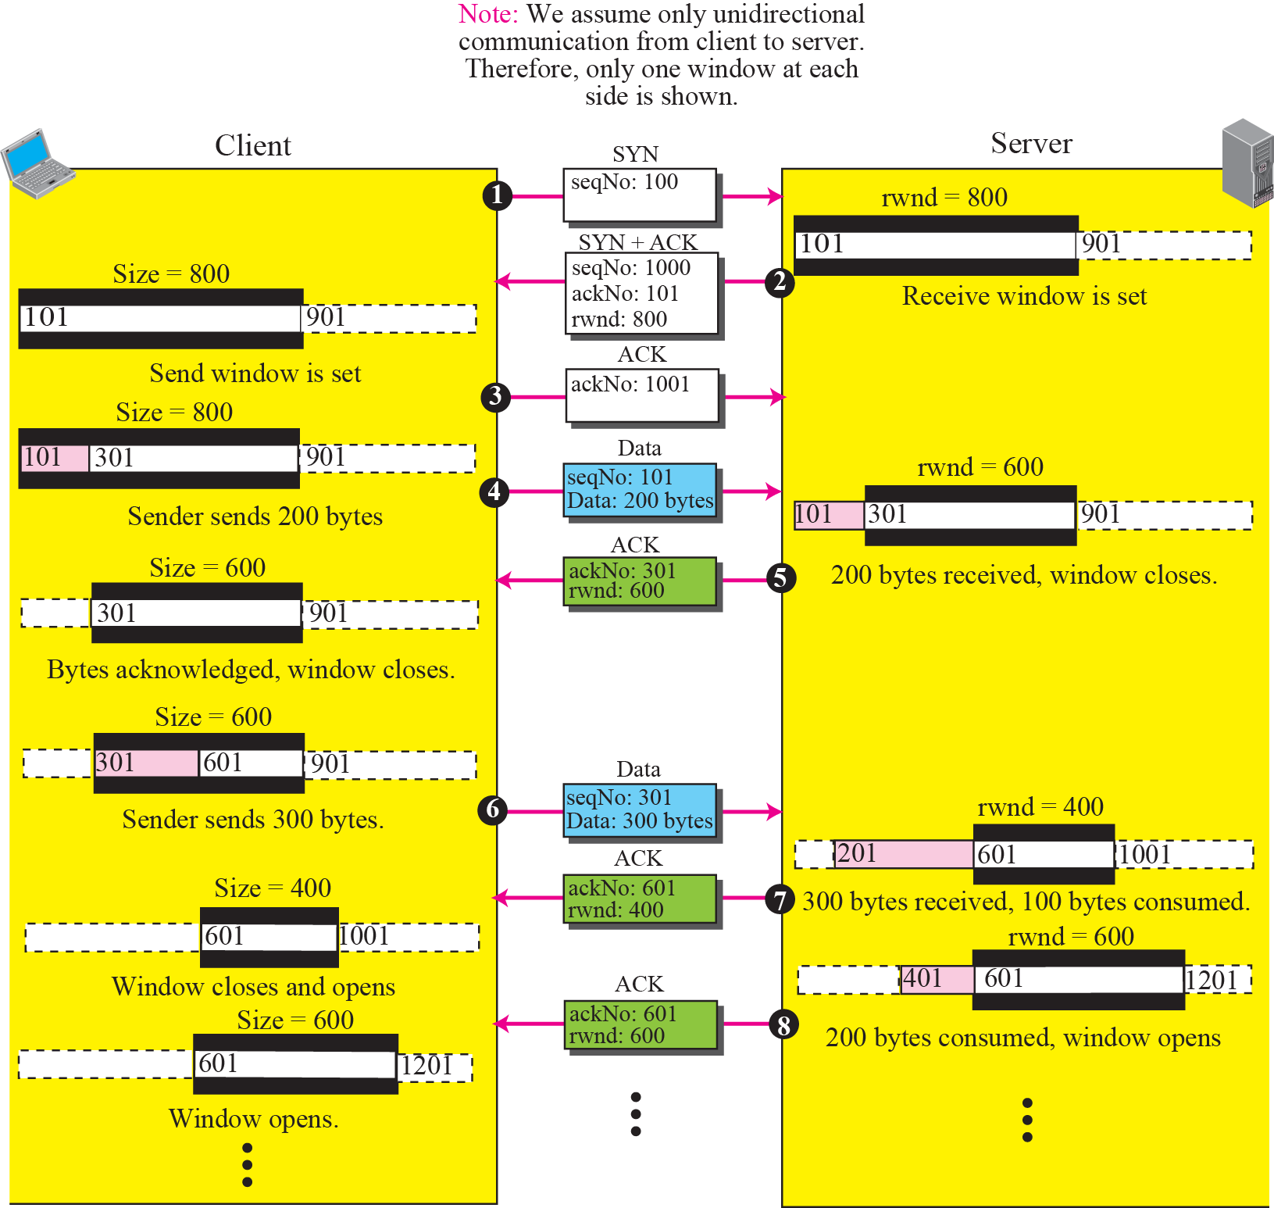
Figure 15.25 An example of flow control
TCP/IP Protocol Suite
‹#›
Notes:
‹#›

Slide 22
Example 15.2
Figure 15.26 shows the reason for the mandate in window shrinking. Part a of the figure shows values of last acknowledgment and rwnd. Part b shows the situation in which the sender has sent bytes 206 to 214. Bytes 206 to 209 are acknowledged and purged. The new advertisement, however, defines the new value of rwnd as 4, in which 210 + 4 < 206 + 12. When the send window shrinks, it creates a problem: byte 214 which has been already sent is outside the window. The relation discussed before forces the receiver to maintain the right-hand wall of the window to be as shown in part a because the receiver does not know which of the bytes 210 to 217 has already been sent. One way to prevent this situation is to let the receiver postpone its feedback until enough buffer locations are available in its window. In other words, the receiver should wait until more bytes are consumed by its process.
TCP/IP Protocol Suite
‹#›
Notes:
‹#›

Slide 23
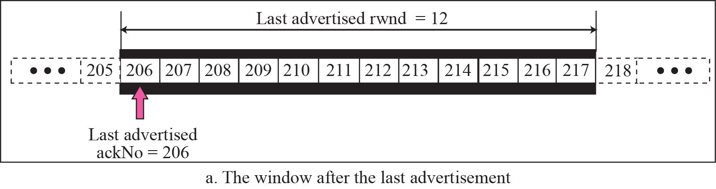
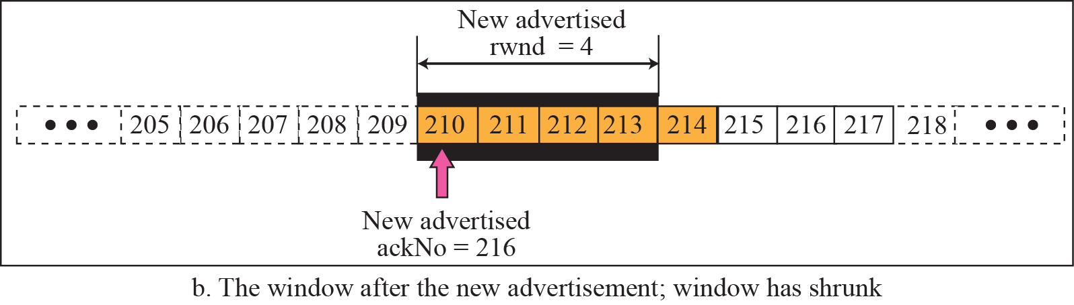
Figure 15.26 Example 15.2
Prevent the shrinking of the send window:
new ackNo + new rwnd >= last ackNo + last rwnd
?
210
TCP/IP Protocol Suite
‹#›
Notes:
‹#›

Slide 24
TCP Flow Control
Problem
Receiver advertise RecvWindow = 0
Window shutdown

Slide 25
Silly Window Syndrome (1)
Sending data in very small segments
Syndrome created by the Sender
Sending application program creates data slowly (e.g. 1 byte at a time)
Wait and collect data to send in a larger block
How long should the sending TCP wait?
Solution: Nagle’s algorithm
Nagle’s algorithm takes into account (1) the speed of the application program that creates the data, and (2) the speed of the network that transports the data
TCP/IP Protocol Suite
‹#›
Notes:
If you’ve already sent data that hasn’t been acknowledged yet, don’t send more small packets — just wait and combine them into one big packet.

Slide 26
Silly Window Syndrome (2)
Syndrome created by the Receiver
Receiving application program consumes data slowly (e.g. 1 byte at a time)
The receiving TCP announces a window size of 1 byte. The sending TCP sends only 1 byte…
Solution 1: Clark’s solution
Sending an ACK but announcing a window size of zero until there is enough space to accommodate a segment of max. size or until half of the buffer is empty
TCP/IP Protocol Suite
‹#›

Slide 27
Silly Window Syndrome (3)
Solution 2: Delayed Acknowledgement
The receiver waits until there is decent amount of space in its incoming buffer before acknowledging the arrived segments
The delayed acknowledgement prevents the sending TCP from sliding its window. It also reduces traffic.
Disadvantage: it may force the sender to retransmit the unacknowledged segments
To balance: should not be delayed by more than 500ms
TCP/IP Protocol Suite
‹#›

Slide 28
TCP
Question:
Is TCP using Selective Repeat or Go-back-N flow mechanism?
Answer:
TCP is mostly Selective Repeat because it buffers out-of-order data and retransmits only missing segments.
However, it has a GBN-like cumulative acknowledgment scheme, not per-packet ACKs as in Selective Repeat.

